Slide 1
Prototype Design Pattern
-Wulan Seruniati Salim-

Slide 2
What is the Prototype Design Pattern?
A creational design pattern
Creates new objects by cloning existing objects
Provides a blueprint for creating new objects
Avoids the cost of creating objects from scratch

Slide 3
Benefits of the Prototype Design Pattern
Improves performance by avoiding expensive object creation
Promotes code reusability by cloning existing objects
Simplifies object creation by providing a blueprint
Enhances flexibility by allowing modifications to cloned objects

Slide 4
Why Needs Prototype Design Pattern?
Not all objects can be copied manually because some of the object’s fields may be private and not visible from outside of the object itself.
You have to know the object’s class to create a duplicate, your code becomes dependent on that class.

Slide 5
Relations with Other Patterns
Abstract Factory classes are often based on a set of Factory Methods, but you can also use Prototype to compose the methods on these classes.

Slide 6
What is the Abstract Factory Design Pattern?
A creational design pattern
Provides an interface for creating families of related objects
Hides concrete product classes from the client
Promotes loose coupling and flexibility

Slide 7
Benefits of the Abstract Factory Design Pattern
Promotes loose coupling by hiding concrete product classes
Improves code maintainability and flexibility
Simplifies switching between product families
Enforces compatibility between related objects

Slide 8
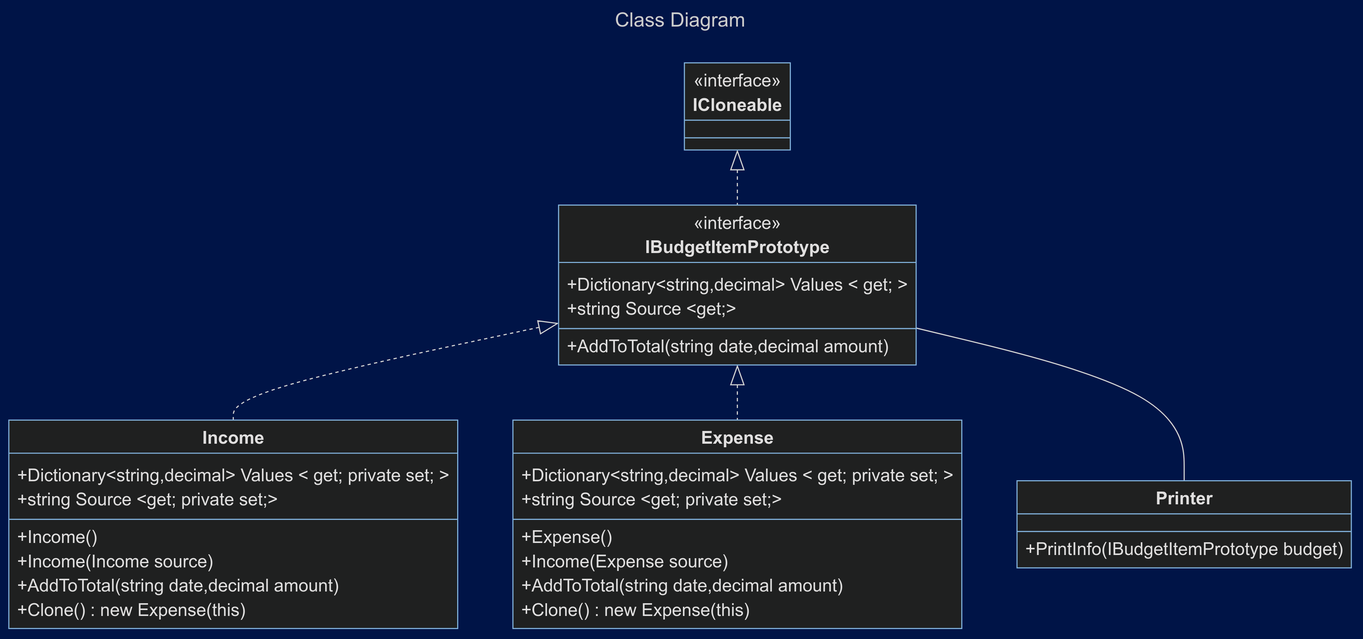
Sample Code – Class Diagram

Slide 9
Thank you☺

